Slide 1
Easy DOE: Easy Enough for a Seven-Year-Old?
Ryan Lekivetz, Manager, DOE & Reliability, JMP
Rory Lekivetz, Rising second grade student

Slide 2
Easy DOE
New platform in JMP 17 (standard)
One “file” that contains Design & Analysis
  No separation of DOE -> data table
Aid novice users through the entire workflow
  Help with hints and defaults
A flexible mode for those more comfortable with DOE

Slide 3
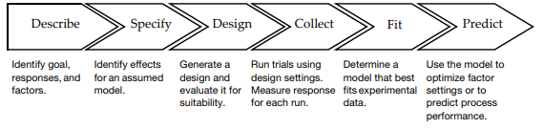
Dad’s purpose
Is Easy DOE easy enough to use?
Let Rory do the steering – with as little input from dad as possible
Needed an introduction to DOE

Slide 4
Experiment
Dad’s suggestions:
Paper Helicopter
Statapult

Slide 5
Experiment
Dad’s suggestions:
Paper Helicopter
Statapult

Slide 6
Experiment
Dad’s suggestions:
Paper Helicopter
Statapult
Rory’s idea:
Paper airplanes
Found a website with instructions for different type + ideas

Slide 7
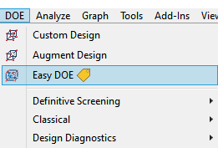


Easy DOE
Under the DOE menu
Go through these tabs with observations from both of us

Slide 8
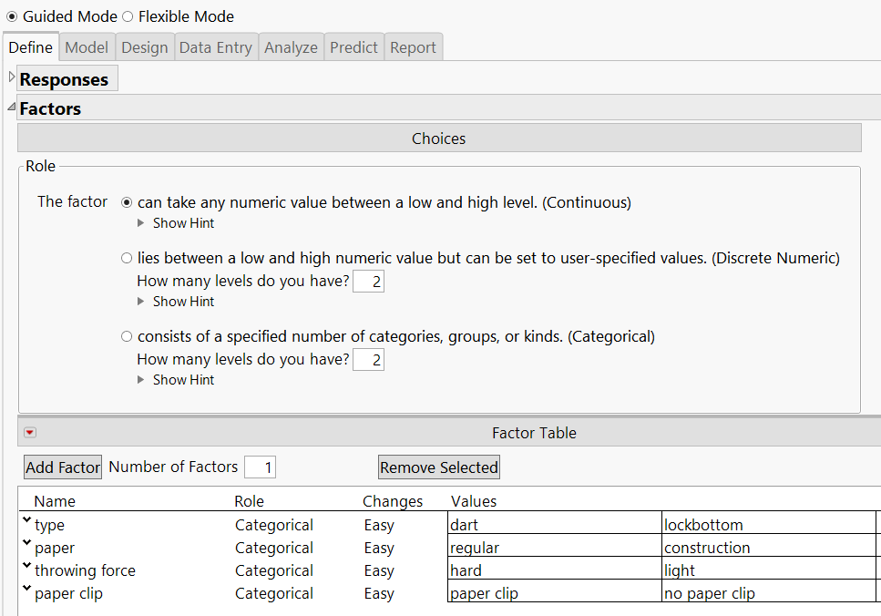
Define
Rory’s thoughts
Type in the different factors and levels we were going to do
None of my factors had numbers, so I chose categorical
Response was distance, I wanted to see what could make it go the farthest (maximize)

Slide 9
Define
Currently Continuous/Discrete Numeric/Categorical factor types
Correctly identified correct factor types, needed confirmation
For little hands used to a touchscreen, needed to inform on the Tab button instead of trying to click into the correct place
Rory picked the 4 factors/levels, but the idea of paper clip took a bit of time to walk through

Slide 10
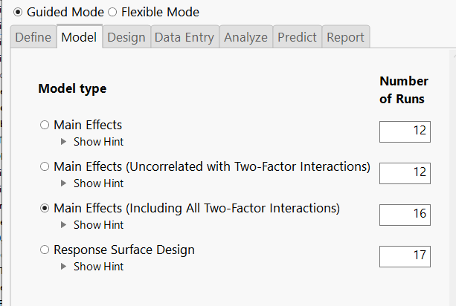
Model
For the model tab, we picked which one we thought would be the best
We decided main effects and two-factor interactions
The number of runs meant we had to make 16 airplanes which didn’t seem too bad

Slide 11
Model
Required the most hand-holding of all the tabs
Important to have some idea of main effects vs. interactions
The paper airplane website effectively spelled out the idea of interactions in relation to the factors we were looking at
  Some airplanes are better when thrown hard while others lightly
Something for to improve upon, how to distinguish between these choices

Slide 12
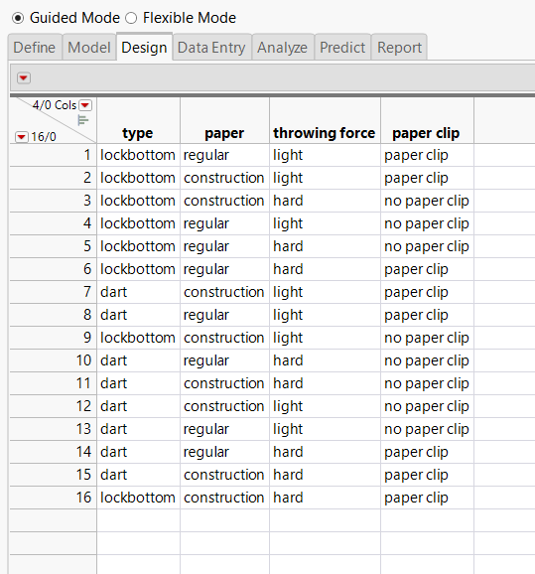
Design
I thought it was interesting that it was showing what kind of paper airplanes you were going to make
Then we had the hard work of making planes and flying them

Slide 13
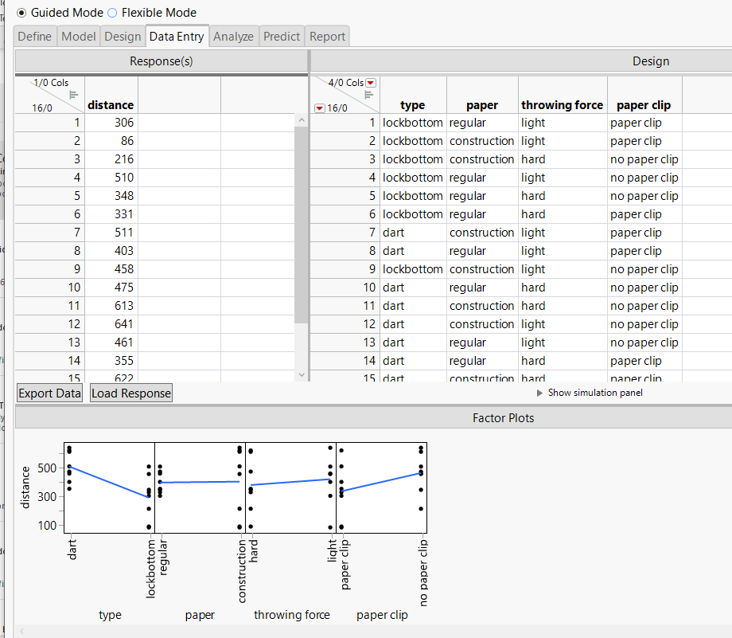
Data Entry
Rory’s thoughts
We put the distance each of the different airplanes flew

Slide 14
Data Entry tab
Factor plots showed what she expected regarding Type (“Lock-bottom is not the best”)
Good teaching moment about randomization
Hard throwing force needed some practice
Seemed straightforward for her to enter

Slide 15
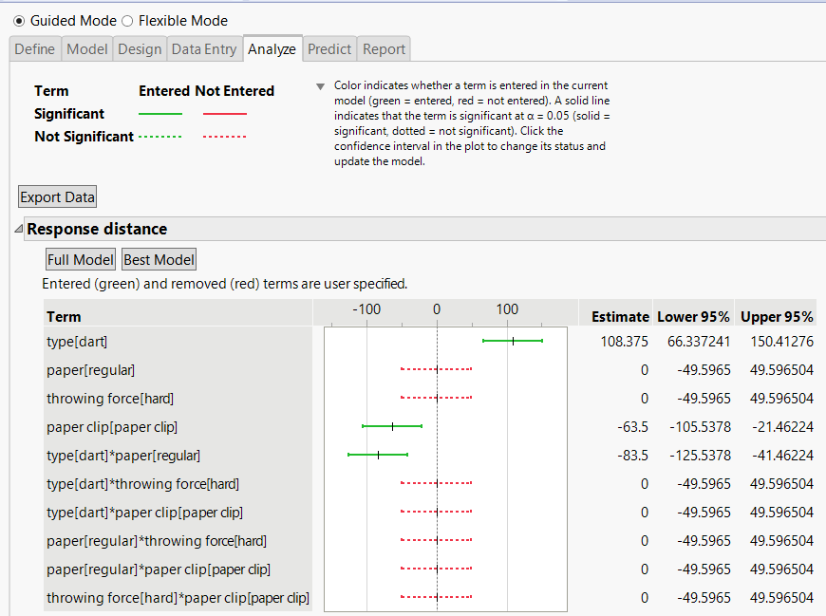
Analyze
Rory’s thoughts
I already kind of knew that dotted ones weren’t the most important ones
I figured out I just needed to click them to get rid of them
Dart type was important

Slide 16
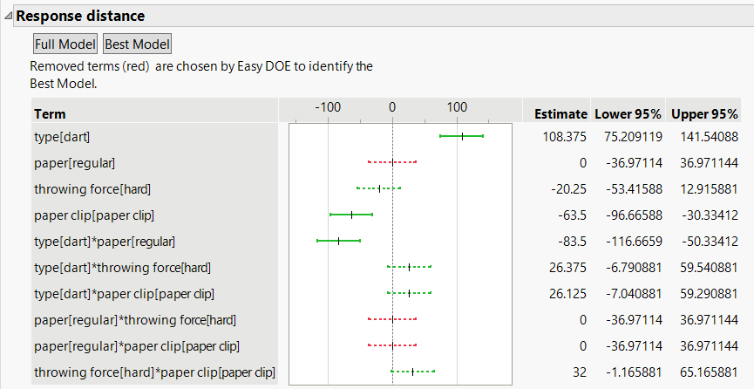
Analyze
Surprisingly easy/effective
“Best” model may have more terms, but couldn’t argue with the results
Discovered the idea of adding/removing terms easily (try it!)
Easier to explain results using the profiler

Slide 17
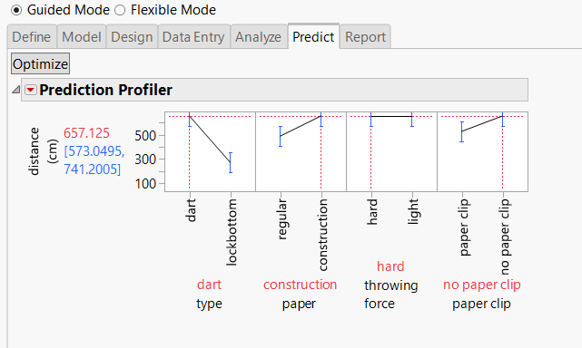
Predict
This tab tells you what the best paper airplane was
If you click on the levels you think are the worst, it shows what might happen with that airplane

Slide 18
Predict
Would help with some previous use of profiler
Intuitive nature of the profiler a real benefit, especially for interactions
Needed to explain what “optimize” might do
The extra model terms made it more interesting

Slide 19
Final questions for Rory
What was your favorite part of the experiment?
What was your least favorite part of the experiment?
What was the most important factor for making a paper airplane go farther? Was there anything else?
What do you want to do for your next experiment?
Was Easy DOE easy?

Slide 20
Thank you!

